Slide 1
How
Bayesian inference
Works

Slide 2
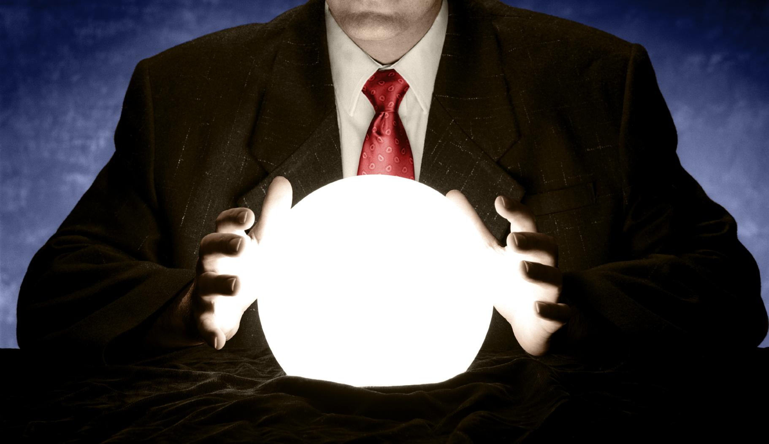
Bayesian inference is not magic

Slide 3
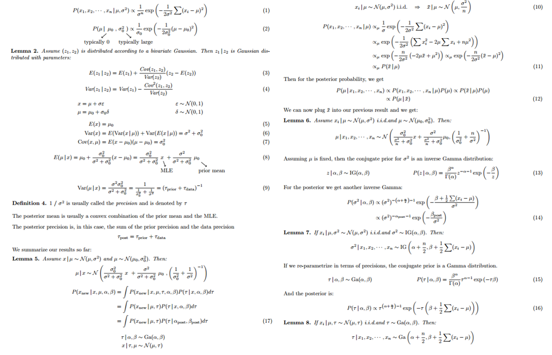
Bayesian inference is not incomprehensible

Slide 4

What does “Bayesian inference” even mean?
Inference = Educated guessing
Thomas Bayes = A non-conformist Presbyterian minister in London back when the United States were still The Colonies.
He also wrote an essay on probability. His friend Richard Price edited and published it after he died.
Bayesian inference = Guessing in the style of Bayes

Slide 5
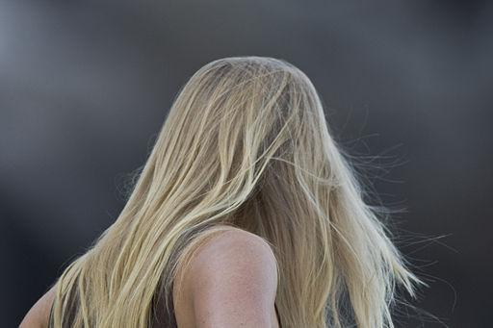
Dilemma at the movies
This person dropped their ticket in the hallway.
Do you call out
“Excuse me, ma’am!”
or
“Excuse me, sir!”
You have to make a guess.

Slide 6
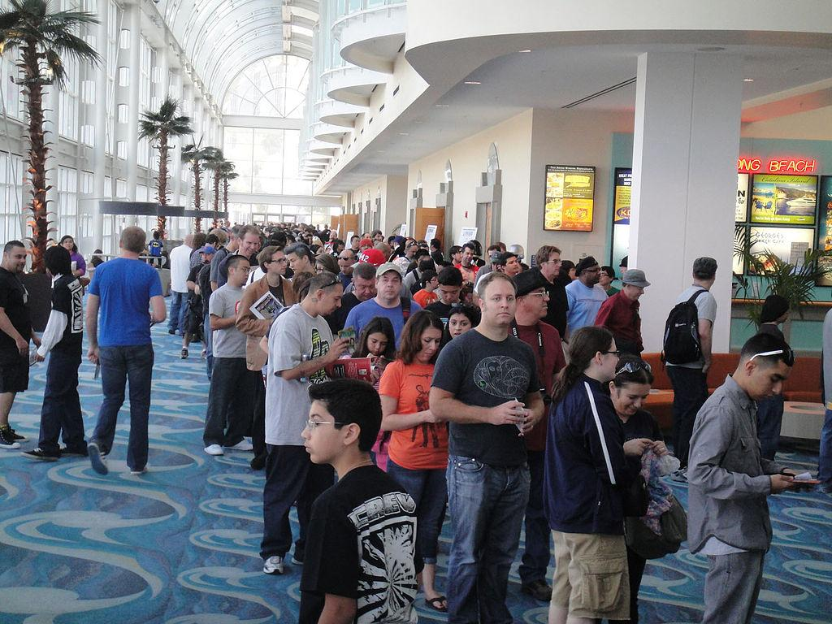
Dilemma at the movies
What if they’re standing in line for the men’s restroom?
Bayesian inference is a way to capture common sense.
It helps you use what you know to make better guesses.

Slide 7
Put numbers to our dilemma
Out of 100 women at the movies
Out of 100 men at the movies
50 have
short hair
50 have
long hair
96 have
short hair
4 have
long hair

Slide 8
Put numbers to our dilemma
Out of 100 women at the movies
Out of 100 men at the movies
50 have
short hair
50 have
long hair
96 have
short hair
4 have
long hair
About 12 times more women have long hair than men.

Slide 9
Put numbers to our dilemma
Out of 2 women
in line
Out of 98 men
in line
1 has
short hair
1 has
long hair
94 have
short hair
4 have
long hair
But there are 98 men and 2 women in line for the men’s restroom.

Slide 10
Put numbers to our dilemma
Out of 2 women
in line
Out of 98 men
in line
1 has
short hair
1 has
long hair
94 have
short hair
4 have
long hair
In the line, 4 times more men have long hair than women.

Slide 11
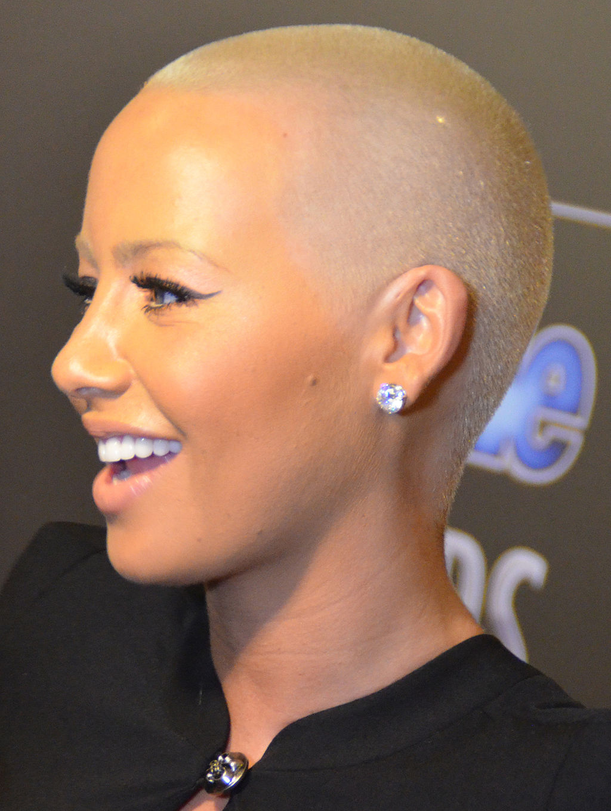
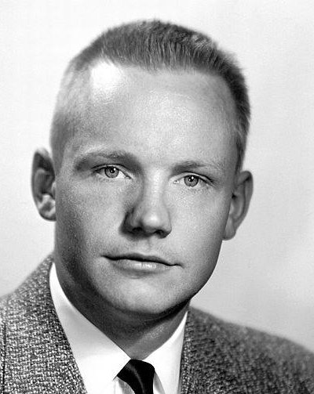
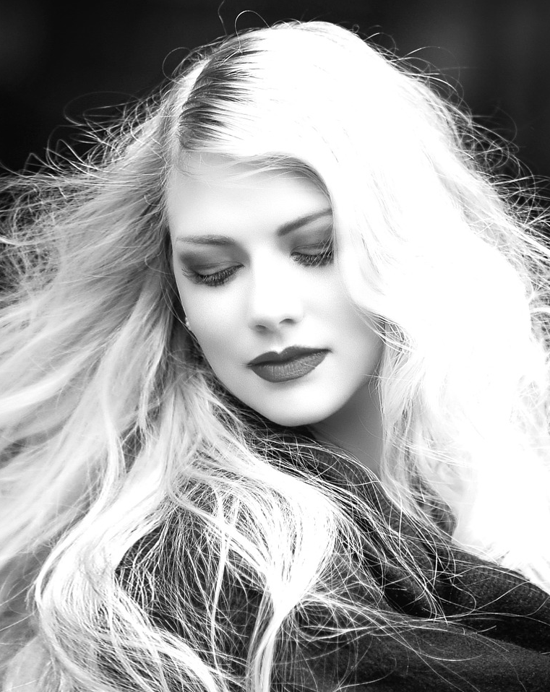
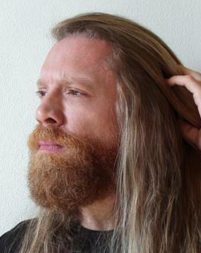
Out of 100 people at the movies
50 are women
50 are men
25 women
have
short hair
48 men
have
short hair
25 women
have
long hair
2 men have long hair

Slide 12
Out of 100 people
In line for the men’s restroom
2 are
women
98 are men
One
woman
has
short
hair
94 men
have
short hair
One
woman
has
long
hair
4 men have long hair

Slide 13
Translate to math
Out of 100 people at the movies
50 are women
50 are men
P(something) = # something / # everything
P(woman) = Probability that a person is a woman
= # women / # people
= 50 / 100 = .5
P(man) = Probability that a person is a man
= # men / # people
= 50 / 100 = .5

Slide 14
Translate to math
Out of 100 people
In line for the men’s restroom
2 are
women
P(something) = # something / # everything
P(woman) = Probability that a person is a woman
= # women / # people
= 2 / 100 = .02
P(man) = Probability that a person is a man
= # men / # people
= 98 / 100 = .98
98 are men

Slide 15
Conditional probabilities
Out of 100 people at the movies
50 are women
P(long hair | woman)
If I know that a person is a woman, what is the probability that person has long hair?
P(long hair | woman)
= # women with long hair / # women
= 25 / 50 = .5
25 women
have
short hair
25 women
have
long hair

Slide 16
Conditional probabilities
Out of 100 people
In line for the men’s restroom
2 are
women
This doesn’t change when we consider people in line.
P(long hair | woman)
= # women with long hair / # women
= 1 / 2 = .5
One
woman
has
short
hair
One
woman
has
long
hair

Slide 17
Conditional probabilities
Out of 100 people at the movies
50 are men
If I know that a person is a man, what is the probability that person has long hair?
P(long hair | man)
= # men with long hair / # men
= 2 / 50 = .04
Whether in line or not.
48 men
have
short hair
2 men have long hair

Slide 18
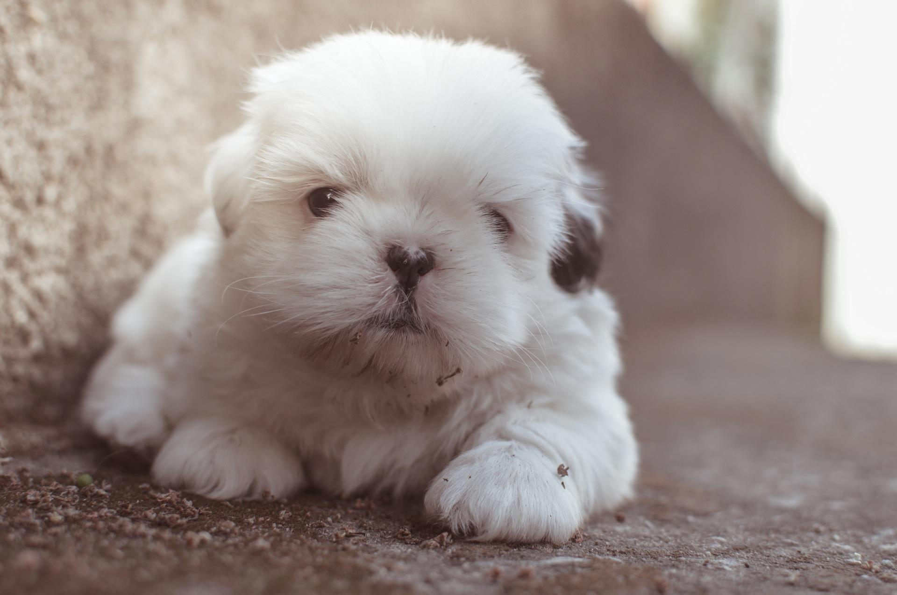
Conditional probabilities
P(A | B) is the probability of A, given B.
“If I know B is the case, what is the probability that A is also the case?”
P(A | B) is not the same as P(B | A).
P(cute | puppy) is not the same as P(puppy | cute)
If I know the thing I’m holding is a puppy, what is the probability that it is cute?
If I know the the thing I’m holding is cute, what is the probability that it is a puppy?

Slide 19
Joint probabilities
Out of probability of 1
P(woman) = .5
P(man) = .5
What is the probability that a person is both a woman and has short hair?
P(woman with short hair)
= P(woman) * P(short hair | woman)
= .5 * .5 = .25
P(woman with short hair) = .25

Slide 20
Joint probabilities
Out of probability of 1
P(woman) = .5
P(man) = .5
P(woman with long hair)
= P(woman) * P(long hair | woman)
= .5 * .5 = .25
P(woman with short hair) = .25
P(woman with long hair) = .25

Slide 21
Joint probabilities
Out of probability of 1
P(woman) = .5
P(man) = .5
P(man with short hair)
= P(man) * P(short hair | man)
= .5 * .96 = .48
P(woman with short hair) = .25
P(man with short hair) = .48
P(woman with long hair) = .25

Slide 22
Joint probabilities
Out of probability of 1
P(woman) = .5
P(man) = .5
P(man with long hair)
= P(man) * P(long hair | man)
= .5 * .04 = .02
P(woman with short hair) = .25
P(man with short hair) = .48
P(woman with long hair) = .25
P(man with long hair) = .02

Slide 23
Joint probabilities
Out of probability of 1
If P(man) = .98 and P(woman) = .02, then the answers change.
P(man with long hair)
= P(man) * P(long hair | man)
= .98 * .04 = .04
P(woman) = .02
P(man) = .98
P(woman
with short
hair) = .01
P(man with short hair) = .94
P(woman
with long
hair) = .01
P(man with long hair) = .04

Slide 24
Joint probabilities
Out of probability of 1
P(woman with long hair)
= P(woman) * P(long hair | woman)
= .02 * .5 = .01
P(woman) = .02
P(man) = .98
P(woman
with short
hair) = .01
P(man with short hair) = .94
P(woman
with long
hair) = .01
P(man with long hair) = .04

Slide 25
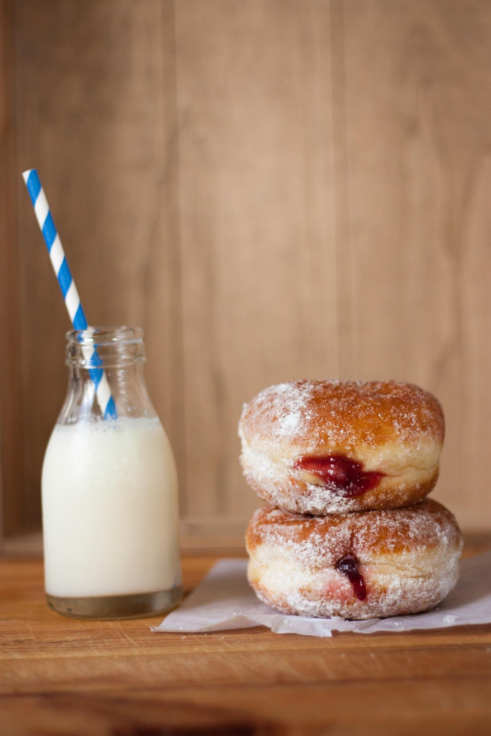
Joint probabilities
P(A and B) is the probability that both A and B are the case.
Also written P(A, B) or P(A ∩ B)
P(A and B) is the same as P(B and A)
The probability that I am having a jelly donut with my milk is the same as the probability that I am having milk with my jelly donut.
P(donut and milk) = P(milk and donut)

Slide 26
Marginal probabilities
Out of probability of 1
P(long hair) = P(woman with long hair) +
P(man with long hair)
= .01 + .04 = .05
P(woman) = .02
P(man) = .98
P(woman
with short
hair) = .01
P(man with short hair) = .94
P(woman
with long
hair) = .01
P(man with long hair) = .04

Slide 27
Marginal probabilities
Out of probability of 1
P(short hair) = P(woman with short hair) +
P(man with short hair)
= .01 + .94 = .95
P(woman) = .02
P(man) = .98
P(woman
with short
hair) = .01
P(man with short hair) = .94
P(woman
with long
hair) = .01
P(man with long hair) = .04

Slide 28
What we really care about
We know the person has long hair. Are they a man or a woman?
P(man | long hair)
We don’t know this answer yet.

Slide 29
Thomas Bayes noticed something cool
P(man with long hair) = P(long hair) * P(man | long hair)

Slide 30
Thomas Bayes noticed something cool
P(man with long hair) = P(long hair) * P(man | long hair)
P(long hair and man) = P(man) * P(long hair | man)

Slide 31
Thomas Bayes noticed something cool
P(man with long hair) = P(long hair) * P(man | long hair)
P(long hair and man) = P(man) * P(long hair | man)
Because P(man and long hair) = P(long hair and man)

Slide 32
Thomas Bayes noticed something cool
P(man with long hair) = P(long hair) * P(man | long hair)
P(long hair and man) = P(man) * P(long hair | man)
Because P(man and long hair) = P(long hair and man)
P(long hair) * P(man | long hair) = P(man) * P(long hair | man)

Slide 33
Thomas Bayes noticed something cool
P(man with long hair) = P(long hair) * P(man | long hair)
P(long hair and man) = P(man) * P(long hair | man)
Because P(man and long hair) = P(long hair and man)
P(long hair) * P(man | long hair) = P(man) * P(long hair | man)
P(man | long hair) = P(man) * P(long hair | man) / P(long hair)

Slide 34
Thomas Bayes noticed something cool
P(man with long hair) = P(long hair) * P(man | long hair)
P(long hair and man) = P(man) * P(long hair | man)
Because P(man and long hair) = P(long hair and man)
P(long hair) * P(man | long hair) = P(man) * P(long hair | man)
P(man | long hair) = P(man) * P(long hair | man) / P(long hair)
P(A | B) = P(B | A) * P(A) / P(B)

Slide 35
Bayes’ Theorem
P(A | B) = P(B | A) P(A)
P(B)

Slide 36
Back to the movie theater, this time with Bayes
P(woman) = .5
P(man) = .5
P(man | long hair) = P(man) * P(long hair | man)
P(long hair)
P(long hair | man) = .04
P(long hair | woman) = .5

Slide 37
Back to the movie theater, this time with Bayes
P(woman) = .5
P(man) = .5
P(man | long hair) = P(man) * P(long hair | man)
P(long hair)
= P(man) * P(long hair | man)
P(woman with long hair) + P(man with long hair)
P(long hair | man) = .04
P(long hair | woman) = .5

Slide 38
Back to the movie theater, this time with Bayes
P(woman) = .5
P(man) = .5
P(man | long hair) = P(man) * P(long hair | man)
P(long hair)
= P(man) * P(long hair | man)
P(woman with long hair) + P(man with long hair)
P(man | long hair) = .5 * .04 = .02 / .27 = .07
.25 + .02
P(long hair | man) = .04
P(long hair | woman) = .5

Slide 39
Back to the movie theater, this time with Bayes
P(man | long hair) = P(man) * P(long hair | man)
P(long hair)
= P(man) * P(long hair | man)
P(woman with long hair) + P(man with long hair)
P(woman) = .02
P(man) = .98
P(long hair | man) = .04
P(long hair | woman) = .5

Slide 40
Back to the movie theater, this time with Bayes
P(man | long hair) = P(man) * P(long hair | man)
P(long hair)
= P(man) * P(long hair | man)
P(woman with long hair) + P(man with long hair)
P(man | long hair) = .98 * .04 = .04 / .05 = .80
.01 + .04
P(woman) = .02
P(man) = .98
P(long hair | man) = .04
P(long hair | woman) = .5

Slide 41
Probability distributions
Probability is like a pot with just one cup of coffee left in it.

Slide 42
Probability distributions
If you only have one cup, you can fill it completely.
100%

Slide 43
Probability distributions
If you have two cups, you have to decide how to share (distribute) it.
27%
73%

Slide 44
Probability distributions
Our people are distributed between two groups, women and men.
50%
50%
Women
Men

Slide 45
Probability distributions
We can distribute them more.
48%
25%
Women with short hair
Men with short hair
25%
2%
Women with long hair
Men with long hair

Slide 46
Probability distributions
P(woman with short hair) = .25
48%
25%
P(man with short hair) = .48
Women with short hair
Men with short hair
P(woman with long hair) = .25
25%
2%
Women with long hair
Men with long hair
P(man with long hair) = .02

Slide 47
Probability distributions
48%
25%
25%
2%
Women with short hair
Women with long hair
Men with short hair
Men with long hair

Slide 48
Probability distributions
.48
.25
.25
.02
Women with short hair
Women with long hair
Men with short hair
Men with long hair

Slide 49
Probability distributions
It’s helpful to think of probabilities as beliefs
Probability
.48
.25
.25
.02
Women with short hair
Women with long hair
Men with short hair
Men with long hair

Slide 50
Probability distributions
Flipping a fair coin
Probability
.5
.5
Heads
Tails

Slide 51
Probability distributions
Rolling a fair die
Probability
.17
.17
.17
.17
.17
.17
1
2
3
4
5
6

Slide 52
Probability distributions
Playing for the Powerball jackpot
.99999999
Probability
.000000001
Lose
Win

Slide 53
Probability distributions
Height of adults in cm
.28
.24
.17
Probability
.12
.09
.06
.03
.01
<150
150 to 160
160 to 170
170 to 180
180 to 190
190 to 200
200 to 210
>210

Slide 54
Probability distributions
Height of adults in cm
.16
.13
.12
.11
.10
Probability
.07
.07
.06
.05
.05
.04
.02
.01
.01
<150
150
to
155
155
to
160
160
to
165
165
to
170
170
to
175
175
to
180
180
to
185
185
to
190
190
to
195
195
to
200
200
to
205
205
to
210
>210

Slide 55
Probability distributions
Height of adults in cm
Probability
150
160
170
180
190
200
210

Slide 56
Probability distributions
Height of adults in cm
Probability
150
160
170
180
190
200
210

Slide 57
Probability distributions
Height of adults in cm
Probability
150
160
170
180
190
200
210

Slide 58
Probability distributions
Height of adults in cm
Probability
150
160
170
180
190
200
210

Slide 59
Probability distributions
Height of adults in cm
Average
(mean)
Probability
150
160
170
180
190
200
210

Slide 60
Probability distributions
Height of adults in cm
Middle
(median)
Probability
150
160
170
180
190
200
210

Slide 61
Probability distributions
Height of adults in cm
Most common
(mode)
Probability
150
160
170
180
190
200
210

Slide 62
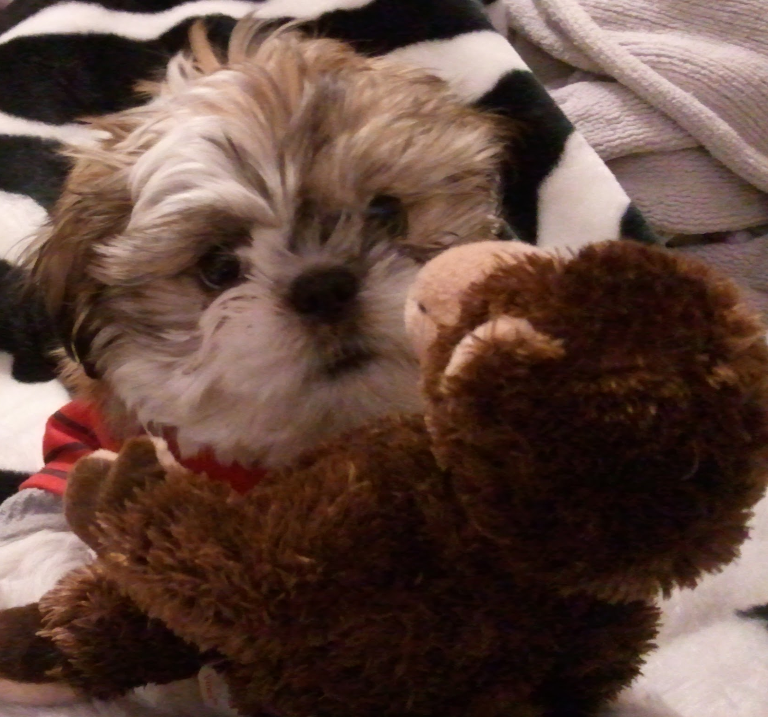
Weighing my dog
My dog is named Reign of Terror.
When we go to the veterinarian, Reign squirms on the scale. Each time we get a different weight measurement.
13.9 lb
17.5 lb
14.1 lb

Slide 63
How much does she weigh?
Take the average.
mean = (13.9 + 17.5 + 14.1) / 3 = 15.2 lb
Calculate the standard deviation.
std dev = sqrt((13.9 - 15.1)^2 + (17.5 - 15.1)^2 + (14.1 - 15.1)^2) / 2 = 2.0 lb
Calculate the standard error.
std err = std dev / sqrt(3) = 1.16

Slide 64
How much does she weigh?
The estimate of the mean is a Normal distribution with a mean of 15.2 lb and a standard deviation of 1.2 lb.
Probability
12
13
14
15
16
17
18
Reign’s weight in pounds

Slide 65
Bayes’ Theorem
P(A | B) = P(B | A) P(A)
P(B)

Slide 66
Bayes’ Theorem
P(w | m) = P(m | w) P(w)
P(m)

Slide 67
Bayes’ Theorem
P(w | m) = P(m | w) P(w)
P(m)
prior

Slide 68
Bayes’ Theorem
P(w | m) = P(m | w) P(w)
P(m)
likelihood

Slide 69
Bayes’ Theorem
P(w | m) = P(m | w) P(w)
P(m)
posterior

Slide 70
Bayes’ Theorem
P(w | m) = P(m | w) P(w)
P(m)
marginal likelihood

Slide 71
Bayes’ Theorem
P(w) = uniform
Start with

Slide 72
Bayes’ Theorem
P(w | m) = P(m | w) C1
C2

Slide 73
Bayes’ Theorem
P(w | m) = P(m | w)
Assumes that the mean of the weight is equally likely to be anything.

Slide 74
P(w | m) = P(m | w)
P(w = 17 | m = [13.9, 14.1, 17.5]) = P(m = [13.9, 14.1, 17.5] | w = 17)
Probability
12
13
14
15
16
17
18
Reign’s weight in pounds

Slide 75
P(w | m) = P(m | w)
P(w = 17 | m = [13.9, 14.1, 17.5]) = P(m = [13.9, 14.1, 17.5] | w = 17)
= P(m = 13.9 | w = 17) * P(m = 14.1 | w = 17) * P(m = 17.5 | w = 17)
Probability
12
13
14
15
16
17
18
Reign’s weight in pounds

Slide 76
P(w | m) = P(m | w)
P(w = 17 | m = [13.9, 14.1, 17.5]) = P(m = [13.9, 14.1, 17.5] | w = 17)
= P(m = 13.9 | w = 17) * P(m = 14.1 | w = 17) * P(m = 17.5 | w = 17)
Probability
12
13
14
15
16
17
18
Reign’s weight in pounds

Slide 77
P(w | m) = P(m | w)
P(w = 17 | m = [13.9, 14.1, 17.5]) = P(m = [13.9, 14.1, 17.5] | w = 17)
= P(m = 13.9 | w = 17) * P(m = 14.1 | w = 17) * P(m = 17.5 | w = 17)
Probability
12
13
14
15
16
17
18
Reign’s weight in pounds

Slide 78
P(w | m) = P(m | w)
P(w = 16 | m = [13.9, 14.1, 17.5]) = P(m = [13.9, 14.1, 17.5] | w = 16)
= P(m = 13.9 | w = 16) * P(m = 14.1 | w = 16) * P(m = 17.5 | w = 16)
Probability
12
13
14
15
16
17
18
Reign’s weight in pounds

Slide 79
P(w | m) = P(m | w)
P(w = 16 | m = [13.9, 14.1, 17.5]) = P(m = [13.9, 14.1, 17.5] | w = 16)
= P(m = 13.9 | w = 16) * P(m = 14.1 | w = 16) * P(m = 17.5 | w = 16)
Probability
12
13
14
15
16
17
18
Reign’s weight in pounds

Slide 80
P(w | m) = P(m | w)
P(w = 15 | m = [13.9, 14.1, 17.5]) = P(m = [13.9, 14.1, 17.5] | w = 15)
= P(m = 13.9 | w = 15) * P(m = 14.1 | w = 15) * P(m = 17.5 | w = 15)
Probability
12
13
14
15
16
17
18
Reign’s weight in pounds

Slide 81
P(w | m) = P(m | w)
mean = 15.2 lb
Also known as a Maximum Likelihood Estimate (MLE)
Probability
12
13
14
15
16
17
18
Reign’s weight in pounds

Slide 82
What would Thomas do?
Start with what we know.
Reign was 14.2 lb the last time we came in.
She doesn’t seem noticeably more heavy to me.
I can start with a prior belief--a bias toward what I think the answer will be.

Slide 83
How much does she weigh?
My prior is a normal curve with a mean at 14.2 lb and a standard error of .5 lb.
Probability
12
13
14
15
16
17
18
Reign’s weight in pounds

Slide 84
How much does she weigh?
My prior is a normal curve with a mean at 14.2 lb and a standard error of .5 lb.
P(w)
Probability
12
13
14
15
16
17
18
Reign’s weight in pounds

Slide 85
Bayes’ Theorem
P(w | m) = P(m | w) P(w)
P(m)
This time I don’t neglect the P(w) term. I still assume the P(m) term is constant.

Slide 86
P(w | m) = P(m | w) * P(w)
P(w = 17 | m = [13.9, 14.1, 17.5]) = P(m = [13.9, 14.1, 17.5] | w = 17)
= P(m = 13.9 | w = 17) *
P(m = 14.1 | w = 17) *
P(m = 17.5 | w = 17)
Probability
P(w)
12
13
14
15
16
17
18
Reign’s weight in pounds

Slide 87
P(w | m) = P(m | w) * P(w)
P(w = 17 | m = [13.9, 14.1, 17.5]) = P(m = [13.9, 14.1, 17.5] | w = 17) * P(w=17)
= P(m = 13.9 | w = 17) * P(w=17) *
P(m = 14.1 | w = 17) * P(w=17) *
P(m = 17.5 | w = 17) * P(w=17)
Probability
P(w)
12
13
14
15
16
17
18
Reign’s weight in pounds

Slide 88
P(w | m) = P(m | w) * P(w)
P(w = 17 | m = [13.9, 14.1, 17.5]) = P(m = [13.9, 14.1, 17.5] | w = 17) * P(w=17)
= P(m = 13.9 | w = 17) * P(w=17) *
P(m = 14.1 | w = 17) * P(w=17) *
P(m = 17.5 | w = 17) * P(w=17)
Probability
P(w)
P(m | w)
12
13
14
15
16
17
18
Reign’s weight in pounds

Slide 89
P(w | m) = P(m | w) * P(w)
P(w = 16 | m = [13.9, 14.1, 17.5]) = P(m = [13.9, 14.1, 17.5] | w = 16) * P(w=16)
= P(m = 13.9 | w = 16) * P(w=16) *
P(m = 14.1 | w = 16) * P(w=16) *
P(m = 17.5 | w = 16) * P(w=16)
Probability
P(w)
P(m | w)
12
13
14
15
16
17
18
Reign’s weight in pounds

Slide 90
P(w | m) = P(m | w) * P(w)
P(w = 15 | m = [13.9, 14.1, 17.5]) = P(m = [13.9, 14.1, 17.5] | w = 15) * P(w=15)
= P(m = 13.9 | w = 15) * P(w=15) *
P(m = 14.1 | w = 15) * P(w=15) *
P(m = 17.5 | w = 15) * P(w=15)
Probability
P(w)
P(m | w)
12
13
14
15
16
17
18
Reign’s weight in pounds

Slide 91
P(w | m) = P(m | w) * P(w)
P(w = 14 | m = [13.9, 14.1, 17.5]) = P(m = [13.9, 14.1, 17.5] | w = 14) * P(w=14)
= P(m = 13.9 | w = 14) * P(w=14) *
P(m = 14.1 | w = 14) * P(w=14) *
P(m = 17.5 | w = 14) * P(w=14)
P(m | w)
Probability
P(w)
12
13
14
15
16
17
18
Reign’s weight in pounds

Slide 92
P(w | m) = P(m | w) * P(w)
Our new estimate of Reign’s weight, P(w | m), is a normal distribution with a mean at about 14.1 lb and a std err of .4 lb.
Also known as Maximum A Posteriori (MAP).
Probability
P(w)
P(w|m)
12
13
14
15
16
17
18
Reign’s weight in pounds

Slide 93
Bayesian vs. not
The Bayesian estimate ignores 17.5 lb like an outlier.
The distribution is narrower. Confidence is greater.
The answer is probably much closer to correct.
Bayesian
estimate
non-Bayesian
estimate
Probability
12
13
14
15
16
17
18
Reign’s weight in pounds

Slide 94
Why we might want to use Bayesian inference
We know things
Age is more than zero
Temperature is greater than -273 Celsius
Height is probably less than 2.4 meters (8 feet)
Starting with a belief helps us get to a confident answer with fewer data points.

Slide 95
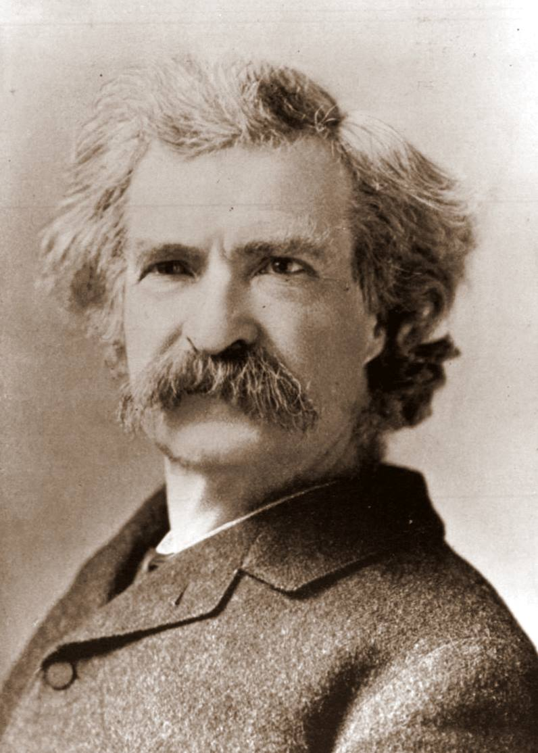
Why Bayesian inference makes us nervous
We’re not always aware of what we believe.
Putting what we believe into a distribution correctly is tricky.
We want to be able to be surprised by our data.
Inaccurate beliefs can make it hard or impossible to learn.
“It ain't what you don't know that gets you into trouble. It's what you know for sure that just ain't so.”
- Mark Twain

Slide 96
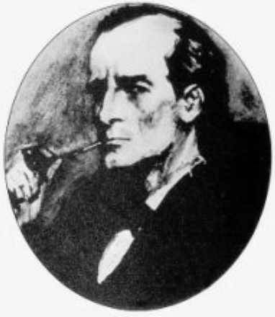
Believe the impossible, at least a little bit
Leave room for believing the unlikely. Leave a non-zero probability unless you are absolutely certain.
“When you have excluded the impossible, whatever remains, however improbable, must be the truth”
- Sherlock Holmes (Sir Arthur Conan Doyle)

Slide 97
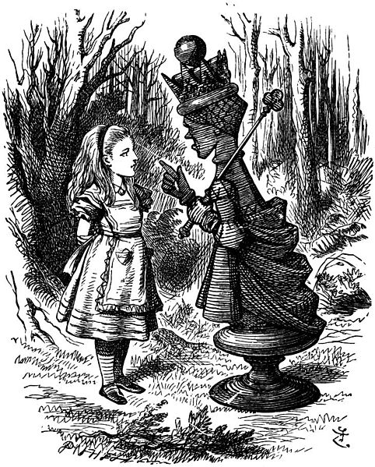
Believe the impossible, at least a little bit
"Alice laughed: "There's no use trying," she said; "one can't believe impossible things."
"I dare say you haven't had much practice," said the Queen. "When I was younger, I always did it for half an hour a day. Why, sometimes I've believed as many as six impossible things before breakfast."
- Lewis Carroll (Alice’s Adventures in Wonderland)

Slide 98

Questions?
Here’s how you can get in touch with me.
brohrer@gmail.com
Blog (Data Science and Robots)
LinkedIn
Twitter
YouTube
Facebook
GitHub
Link to these slides:
https://docs.google.com/presentation/d/1325yenZP_VdHoVj-tU0AnbQUxFwb8Fl1VdyAAUxEzfg/edit?usp=sharing

Slide 99
Acknowledgements
Businessman Consulting Glowing Crystal Ball, InfoWire.dk, Public domain
Equation images from The Conjugate Prior for the Normal Distribution, Michael I. Jordan, Teodor Mihai Moldovan, February 8 th, 2010
Portrait of an unknown 19th-century Presbyterian clergyman. Identified as Thomas Bayes, Public domain
Woman blond hair, face long hair laleyla5, pixabay, Public Domain
hairfreaky long hair, Creative Commons 2.0
Amber Rose at the "PEOPLE Magazine Awards”, Creative Commons Attribution-Share Alike 2.0 Generic
Neil Armstrong, Public Domain
A blond long-haired young lady-woman, "Mike" Michael L. Baird, Creative Commons Attribution 2.0 Generic
White Long Coated Puppy, Creative Commons Zero
Long Beach Comic & Horror Con 2011, Creative Commons 2.0
Donuts and milk, Creative Commons Zero
Photo of Reign of Terror, Diane Rohrer under Creative Commons Zero
Mark Twain, Public domain
Sherlock Holmes, Public domain
Red Queen with Alice, Public domain

Slide 100
How
Bayesian Inference
Works
by Brandon Rohrer
P(A | B) = P(B | A) P(A)
P(B)
Bayesian
estimate
non-Bayesian
estimate
Probability
12
13
14
15
16
17
18
Weight in pounds

Slide 101
non-Bayesian
estimate
Bayesian
estimate

